Slide 1

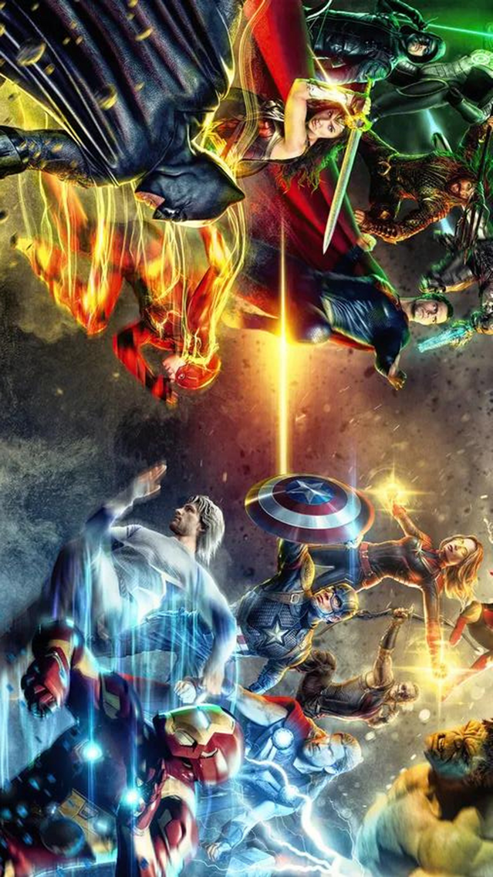
MARVEL VS DC:
A COMPREHENSIVE BOX OFFICE PERFORMANCE STUDY
PRESENTED BY: BI BEES
Amisha Shrestha (C0932086)
Keerthi Reddy (C0930079)
Srikanth Veeramalla (C0924034)
Feby Varughese (C0936375)

Slide 2




Project Overview
Project Flow
Focus on comparing Marvel and DC superhero movies' box office success.
1. Data Collection and Preparation
Dataset Source: Kaggle
Data Transformation: Power Query for data cleaning, transformation, and integration.
2. Data Analysis
DAX Functions: Used for calculating metrics and creating measures like Success Rate, Total Marvel and DC Collections, Weighted Gross Collection to Budget Ratio
Statistical Functions: Applied for analyzing trends, averages, and distributions.
3. Visualization
Dashboard Design: Layout and visual representation of data in Power BI.
Key Visuals: Bar charts, line charts, scatter plots, and tables for box office collections, budget vs. collections, and critical scores.
4. Conclusions and Recommendations
Insights: Summary of Marvel’s Success, DC's Potential, Key Factors.
Implications: The insights mean for investment strategies and future projects.
Recommendations: Suggested actions based on the data analysis and insights.
01
02
Objective: Identify key factors driving financial success in superhero films.
Analyzes franchise impact, budget efficiency, release timing, and lead roles.
03
Goal: Provide insights to guide future strategies for maximizing revenue and audience engagement.
04

Slide 3


Movie Production Studios:
Financial Returns Optimization: Insights on budget allocation and franchise affiliation.
Franchise Development: Guidance on prioritizing character families and story arcs.
Investors:
Financial Returns Optimization: Data-backed insights for profitable investments.
Strategic Planning: Confidence in long-term franchise success and market potential.
01
04
Target Consumers
Distributors:
Strategic Planning: Data-driven decisions on release timing to maximize reach.
Financial Returns Optimization: Identifying optimal release windows.
Film Critics:
Diversity and Inclusion: Analyzing the impact of progressive themes in superhero films.
02
05
Their Needs, and Expectations
Marketing Teams:
Strategic Planning: Content resonance and effective marketing strategies.
Diversity and Inclusion: Understanding the impact of diverse narratives on audience engagement.
Movie Enthusiasts
Insights on the performance of their favorite characters and franchises, understanding of box office trends, and anticipation of future films.
03
06

Slide 4
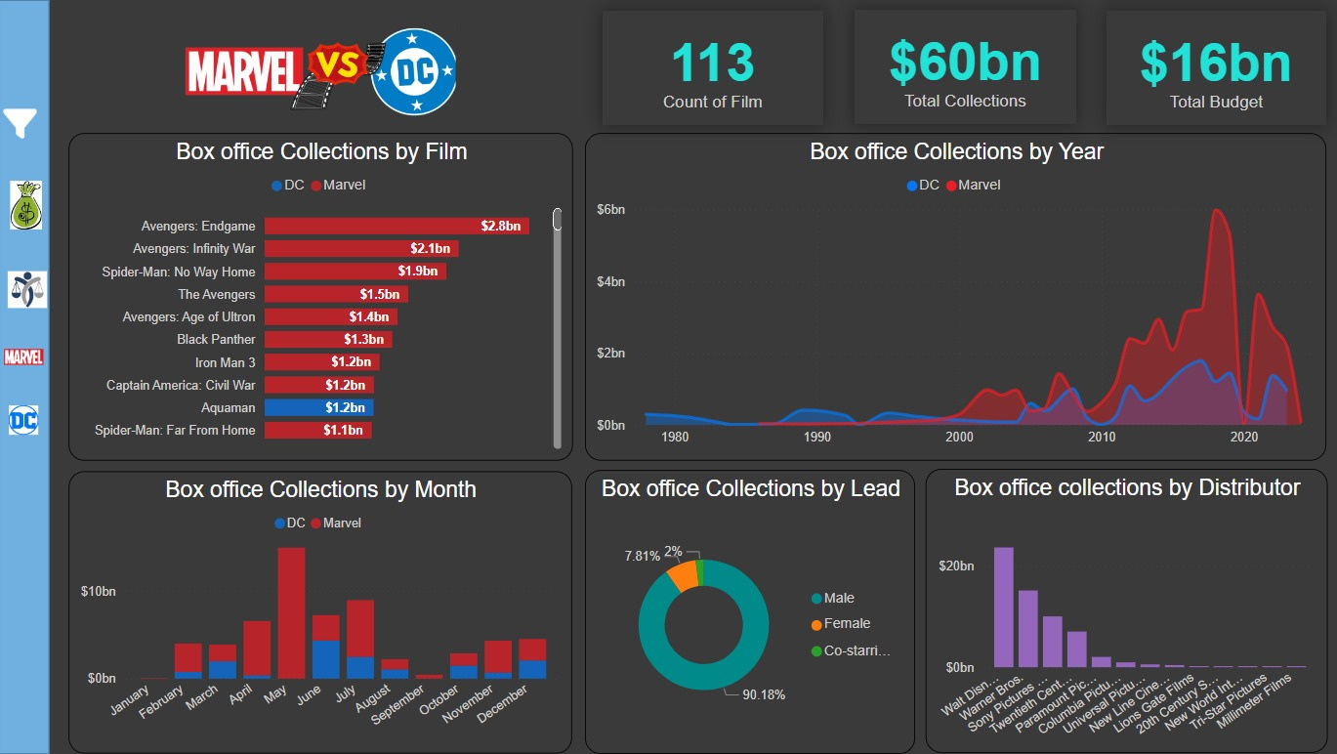
Box Office Collections
Avengers: Endgame: Highest-grossing film with almost $2.8 billion.
Marvel Dominance: 9 out of top 10 highest-grossing films are Marvel movies
Interest peaked for superhero movies from 2010 to 2020.
Male-led movies dominate the box office collections with 90%, but female-led movies also show substantial earnings.
Movies released in May and June show significantly higher box office collections, indicating the strength of summer releases.
Approximately 80% of the box office share is dominated by Walt Disney, Warner Bros., and Sony Pictures, highlighting their significant influence in the distribution of high-grossing films.

Slide 5
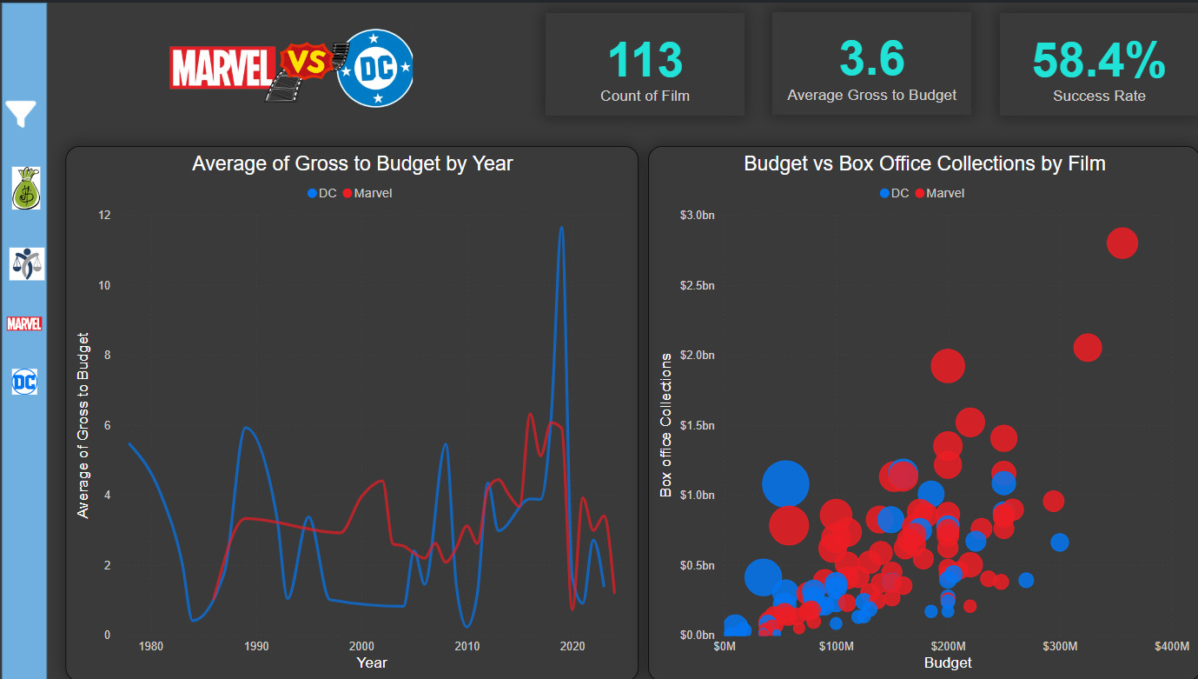
Gross Budget and Collection
On average, for every dollar spent on production, the movies generated 3.6 dollars in gross revenue.
58.4% of the films in the dataset were financially successful, defined as making a profit.
In the late 2000s and early 2010s, Marvel movies showed a higher average gross to budget ratio compared to DC.
Both Marvel and DC saw spikes in their gross to budget ratios around 2018 and 2019.
Post-2020, there is a noticeable decline in the gross to budget ratio for both Marvel and DC.
Marvel films, represented by red dots, are clustered towards higher budgets and higher collections compared to DC films, represented by blue dots.
Some lower-budget DC films still achieve substantial box office collections, indicating efficient use of resources.

Slide 6
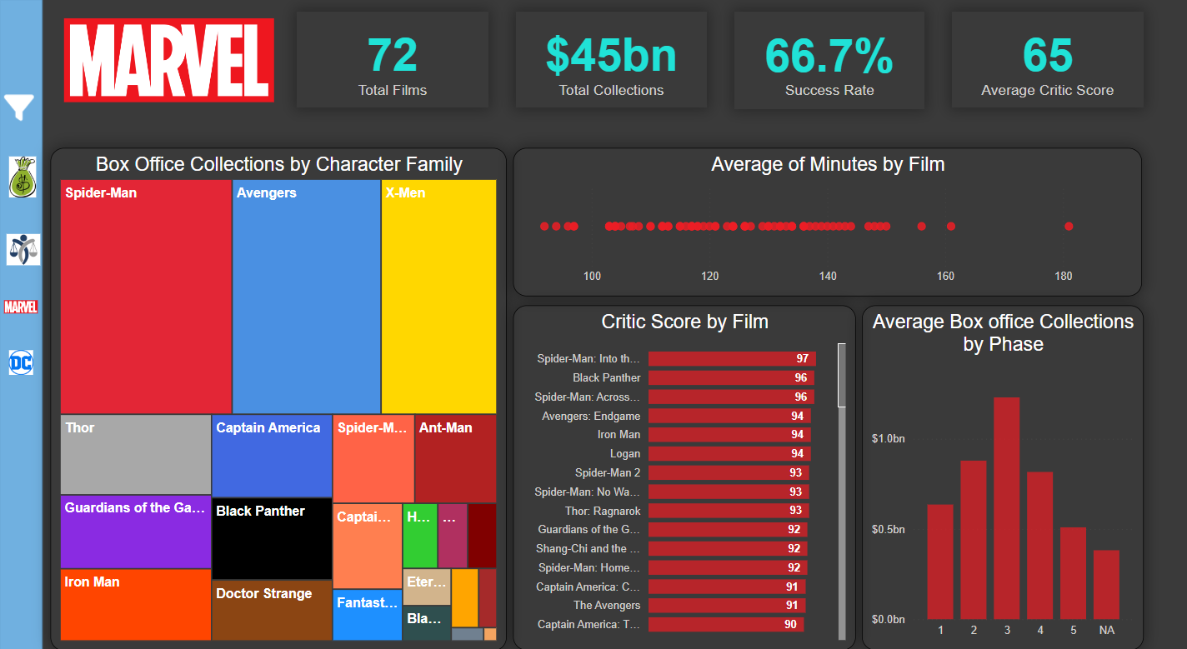
Spider-Man and Avengers are the top performers, contributing the largest share to Marvel's box office collections.
X-Men also holds a significant share, despite not being part of the main MCU.
About 66.7% of the Marvel films are successful based on their box office performance relative to their budgets.
The average critic score across all Marvel films is 65 out of 100.
Most Marvel films are within the 120-150 minute range.
No film falls significantly below 100 minutes.
Phase 3 stands out as the most financially successful, with average collections approaching $1 billion per film.
Non-Attributed Films (NA) are films, not assigned to a specific phase, have lower average collections, representing older or less prominent entries in the Marvel catalog
Spider-Man: Into the Spider-Verse" and "Black Panther" lead with the highest critic scores .
Many films, including "Avengers: Endgame," "Iron Man," and "Logan," score above 90.

Slide 7

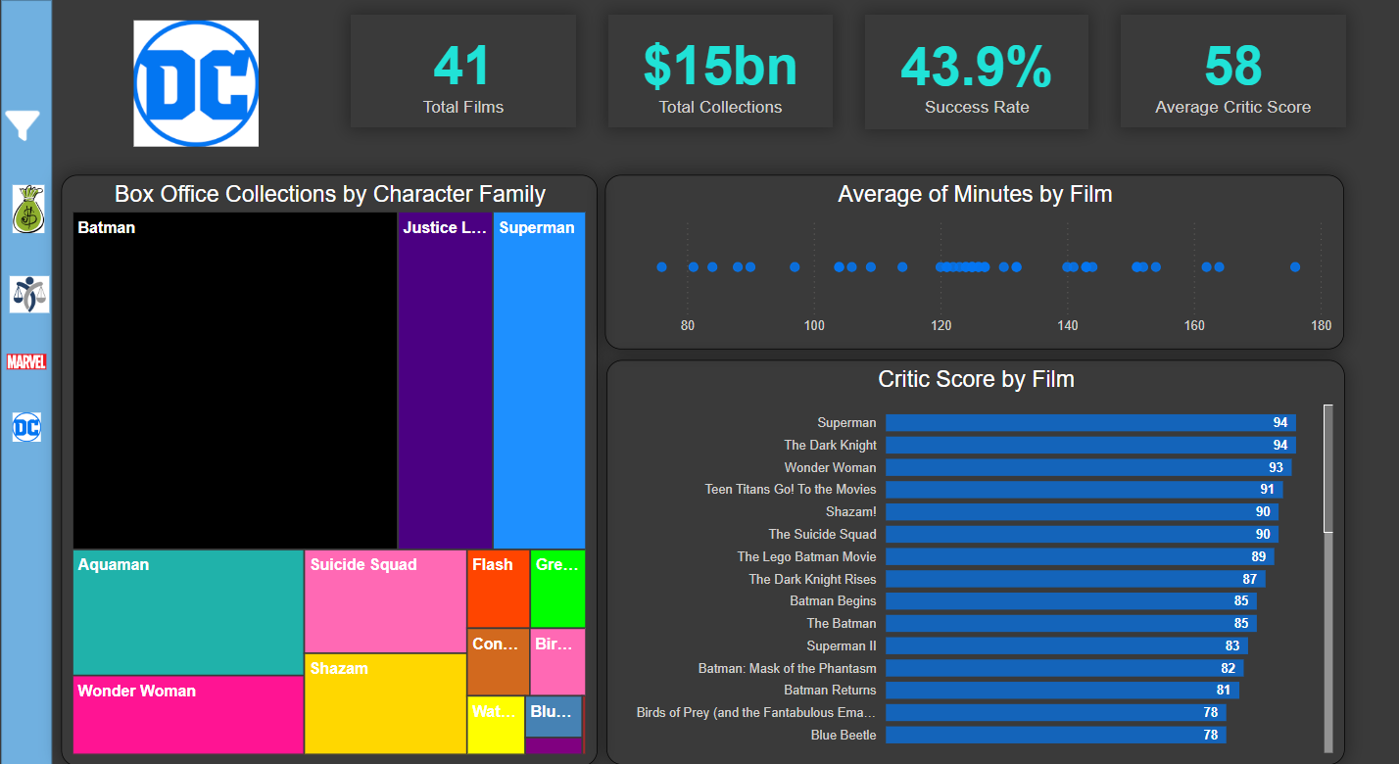
A 43.9% success rate suggests that less than half of the films were considered successful
Batman is the dominant force in DC’s box office collections, contributing the largest share.
Justice League and Superman are also significant contributors.
Characters like Aquaman and Wonder Woman contribute meaningfully.
Superman and The Dark Knight tie for the highest critic scores at 94.
Wonder Woman also receives a high critic score, reflecting positive reception for female-led superhero films.
There’s a noticeable drop in scores for some films, indicating mixed critical reception across the franchise.
DC films display a broader range of runtimes, with several films around the 120-minute mark but also notable outliers.
There are both shorter films under 100 minutes and longer films over 160 minutes, suggesting flexibility in storytelling.

Slide 8



Slide 9
Summary of Insights
Strategic Implementations
By leveraging the insights gained from analyzing Marvel and DC's successes and challenges, stakeholders can make informed decisions on future projects.
Emphasizing diversity, inclusivity, and innovation will be essential in maintaining and expanding audience engagement in an evolving market.
Ongoing analysis of market trends and audience preferences will be key to sustaining long-term success in the competitive landscape of superhero movies.
Marvel's consistent box office success highlights the power of strong brand development, strategic storytelling, and effective character utilization.
DC has demonstrated significant potential, particularly with iconic characters like Batman, but requires more consistency and strategic planning to close the gap with Marvel.
Timing, budget allocation, and distribution channels play crucial roles in maximizing financial returns and audience engagement in the superhero movie industry.
The success of superhero movies is not just about big budgets or iconic characters; it’s about strategic alignment between production, distribution, and audience expectations. With the right insights and data-driven decisions, both Marvel and DC, along with other franchises, have the potential to continue thriving in the global entertainment industry.
Marvel vs DC Dashboard URL: Live Dashboard

